Slide 1
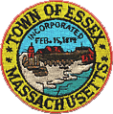
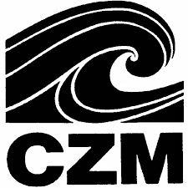

Massachusetts Office OF Coastal Zone Management
Coastal Resilience Grant Program
Apple Street Alternate Transportation Route
Feasibility Study
Town of Essex

Slide 2
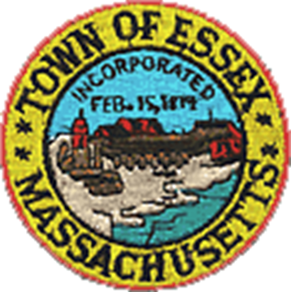
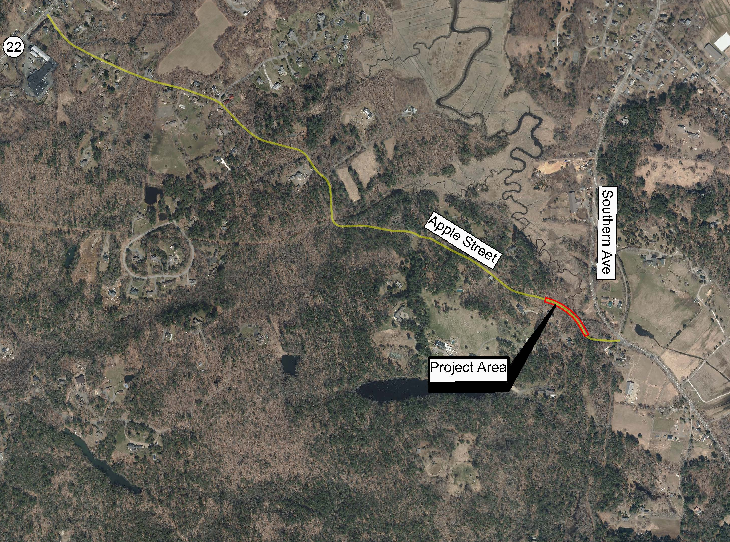
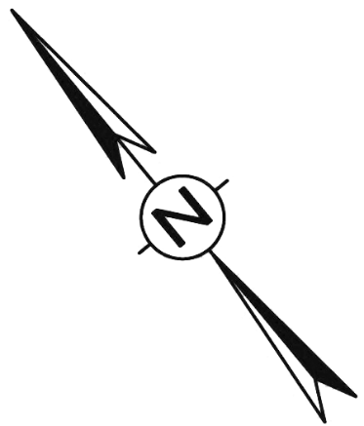
Project Location
Essex River
TO 128
Notes:
This is an overview of the project area. The project limits are outlined by the red dash line.
Just to orient everyone the Merrimack River is here at the southerly limits of the project and the Spicket River is here at the northerly end of the project. This is O’Neill Park here.
The work will start about 500’ south of Canal Street near the Joseph Casey Bridge. It will extend along Amesbury Street to the intersection of Lawrence Street. It will include the intersections of Canal Street, Methuen Street, Essex Street, Common Street, Lowell Street Haverhill Street, Lebanon Street and Lawrence Street. The total length of work on Amesbury Street is about 3000’.
The project also includes Lawrence Street from about Lebanon Street to Marion Avenue and will include the intersection of Amesbury Street and Maple Street. The total length of work on Amesbury Street is about 1000’.

Slide 3
Project Description
During coastal storm surge events, the causeway on Route 133 typically floods, making Route 133 impassable requiring all traffic to be detoured. If the event is large enough, the only other roadway in Essex linking both halves of the community (Apple Street) also floods due to two existing low points along Apple Street:
  “Phase 1”: Located approximately 120 feet north of Southern Ave where the Essex River crosses under Apple Street via a 36-inch diameter culvert.
  “Phase 2”: Located approximately 200 feet north of the culvert. This low point is the focus of the feasibility study.
The Town of Essex has received a grant under the Coastal Resilience Grant Program to study the feasibility of raising the second low point on Apple Street (“Phase 2”) which is subjected to flooding during storm events above the measured flood elevation of 13.7’.
Notes:
Thank You Pedro.
Hello everyone. I would like to thank the City of Lawrence for inviting us here this evening to talk to you about this great project.
My name is Lori Aho, I am a transportation engineer and project manager at TEC.
Also joining me here this evening from TEC is Liz Oltman who is the Transportation Planning Director and Jonathan Rockwell who is the Director of Transportation Infrastructure Services.
TEC has worked closely with the City of Lawrence over the past several months on this project and we are excited to present this design to you this evening.
Let me start by saying that we are in the early stages of this project. This meeting is one of the first steps in the process to present the project to you the community so you can ask questions and to provide us with feedback. Also this will not be the only public meeting held. For example we will also hold a public meeting during the 25% design stage which is another opportunity for the community to see the project, ask questions and provide feedback.
This slide outlines the Project Goals which I will discuss in more detail as we move through the presentation.
The goals are:
To improve downtown connectivity by converting Amesbury Street from one-way to two-way travel.
Enhance safety and operations along the corridor.
Promote healthy transportation by improving bicycle & pedestrian mobility.
Revitalize Downtown Lawrence by providing additional vehicular and multi-modal access to adjacent commercial and educational land uses.

Slide 4
Work Performed to Date as Part of “Phase 1”
Part of Division of Ecological Restoration (DER) Culvert Replacement Municipal Assistance (CRMA) Grant Program.
Existing Conditions Survey by Meridian Associates, Inc – Feb. 2020
Wetland Delineation by Derosa Environmental Consulting, Inc – Feb. 2020
Geotechnical Investigation and Analysis by Geosciences Testing and Research, Inc., April 2020.
Hydrologic and Hydraulic Analysis for Stream Crossing Structure Replacement Apple Street Over Essex River by DuBois & King Inc., April 2020
Apple Street Culvert Replacement Data Collection and Assessment Preliminary Culvert Design Memo by TEC, June 2020.
Notes:
Thank You Pedro.
Hello everyone. I would like to thank the City of Lawrence for inviting us here this evening to talk to you about this great project.
My name is Lori Aho, I am a transportation engineer and project manager at TEC.
Also joining me here this evening from TEC is Liz Oltman who is the Transportation Planning Director and Jonathan Rockwell who is the Director of Transportation Infrastructure Services.
TEC has worked closely with the City of Lawrence over the past several months on this project and we are excited to present this design to you this evening.
Let me start by saying that we are in the early stages of this project. This meeting is one of the first steps in the process to present the project to you the community so you can ask questions and to provide us with feedback. Also this will not be the only public meeting held. For example we will also hold a public meeting during the 25% design stage which is another opportunity for the community to see the project, ask questions and provide feedback.
This slide outlines the Project Goals which I will discuss in more detail as we move through the presentation.
The goals are:
To improve downtown connectivity by converting Amesbury Street from one-way to two-way travel.
Enhance safety and operations along the corridor.
Promote healthy transportation by improving bicycle & pedestrian mobility.
Revitalize Downtown Lawrence by providing additional vehicular and multi-modal access to adjacent commercial and educational land uses.

Slide 5
Work Performed to Date as Part of “Phase 2”
Part of Coastal Zone Management Coastal Resilience Grant Program
Existing Conditions Survey by Meridian Associates, Inc – Nov. 2020
Wetland Delineation by Derosa Environmental Consulting, Inc – Nov. 2020
Feasibility Study: “Elevation of Apple Street for Alternate Transportation Route”, prepared by TEC, Inc. – Jan. 2021
Notes:
Thank You Pedro.
Hello everyone. I would like to thank the City of Lawrence for inviting us here this evening to talk to you about this great project.
My name is Lori Aho, I am a transportation engineer and project manager at TEC.
Also joining me here this evening from TEC is Liz Oltman who is the Transportation Planning Director and Jonathan Rockwell who is the Director of Transportation Infrastructure Services.
TEC has worked closely with the City of Lawrence over the past several months on this project and we are excited to present this design to you this evening.
Let me start by saying that we are in the early stages of this project. This meeting is one of the first steps in the process to present the project to you the community so you can ask questions and to provide us with feedback. Also this will not be the only public meeting held. For example we will also hold a public meeting during the 25% design stage which is another opportunity for the community to see the project, ask questions and provide feedback.
This slide outlines the Project Goals which I will discuss in more detail as we move through the presentation.
The goals are:
To improve downtown connectivity by converting Amesbury Street from one-way to two-way travel.
Enhance safety and operations along the corridor.
Promote healthy transportation by improving bicycle & pedestrian mobility.
Revitalize Downtown Lawrence by providing additional vehicular and multi-modal access to adjacent commercial and educational land uses.

Slide 6
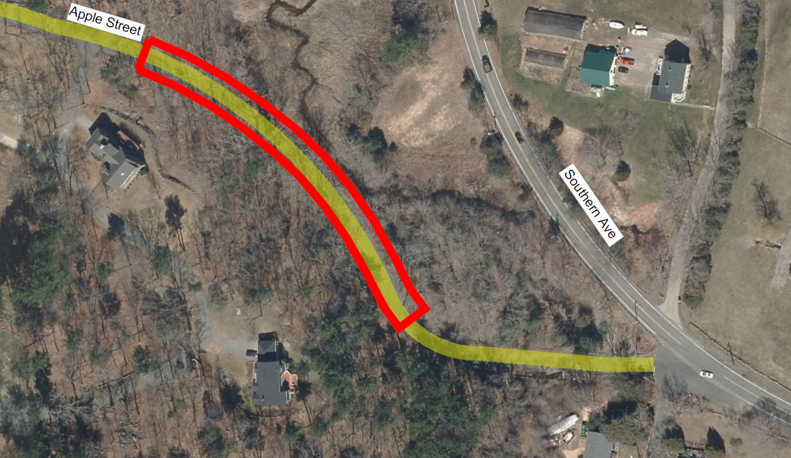
Existing Conditions
& Challenges
Bordering Vegetated Wetlands
Narrow 18’ wide Roadway Cross Section
Low Point 2
200’ north of culvert
Low Point 1 at Existing Culvert
Notes:
I will now turn over the presentation to Liz Oltman who will talk about traffic along the corridor.

Slide 7
Proposed Alternatives
Alternative 1 – Raise Apple Street to Elevation 14.0’
Raise the existing Low Point 3.2’
Widen the Roadway to 20’ wide
Modified Rockfill Slope Adjacent to Wetlands
Notes:
This is my favorite part of the presentation where we get to talk about the proposed improvements along the corridor.
MassDOT has a healthy transportation directive to ensure that all MassDOT projects are designed and implemented in a way that all users have access to safe and comfortable healthy transportation options including walking, bicycling and taking transit. Roadways need to meet the needs of all users.
Since the City of Lawrence will be seeking state and federal funding to construct the proposed improvements the project will need to meet MassDOT and federal standards.
Adhering to MassDOT’s policies and guidelines we want to strive to design the project to meet the needs of all users which you will see in the proposed improvements presented in these slides.
Amesbury Street will be converted from One-way to Two-way travel which will improve access to commercial properties along the corridor.
Bicycle lanes will be provided along both sides of Amesbury Street.
Pavement Restoration – repave Amesbury Street throughout the project limits in areas where the pavement is in poor condition we may need to replace the entire roadway material including the gravel subbase. During the preliminary design we will test the existing roadway to and make recommendations.
Sidewalks that are in poor shape or do not meet current standards will be reconstructed and replaced with new sidewalk.
Existing traffic signals at the intersection of Canal Street and Essex Street will be upgraded with new traffic signals.
The roadway will be restriped including new crosswalks and bike lanes and new signs will be installed.

Slide 8
Proposed Alternatives
Alternative 2 – Raise Apple Street to Elevation 14.0’ – With Retaining Wall
Raise the existing Low Point 3.2’
Widen the Roadway to 20’ wide
270’ of New Retaining Wall, Adjacent to Wetlands
Notes:
This is my favorite part of the presentation where we get to talk about the proposed improvements along the corridor.
MassDOT has a healthy transportation directive to ensure that all MassDOT projects are designed and implemented in a way that all users have access to safe and comfortable healthy transportation options including walking, bicycling and taking transit. Roadways need to meet the needs of all users.
Since the City of Lawrence will be seeking state and federal funding to construct the proposed improvements the project will need to meet MassDOT and federal standards.
Adhering to MassDOT’s policies and guidelines we want to strive to design the project to meet the needs of all users which you will see in the proposed improvements presented in these slides.
Amesbury Street will be converted from One-way to Two-way travel which will improve access to commercial properties along the corridor.
Bicycle lanes will be provided along both sides of Amesbury Street.
Pavement Restoration – repave Amesbury Street throughout the project limits in areas where the pavement is in poor condition we may need to replace the entire roadway material including the gravel subbase. During the preliminary design we will test the existing roadway to and make recommendations.
Sidewalks that are in poor shape or do not meet current standards will be reconstructed and replaced with new sidewalk.
Existing traffic signals at the intersection of Canal Street and Essex Street will be upgraded with new traffic signals.
The roadway will be restriped including new crosswalks and bike lanes and new signs will be installed.

Slide 9
Proposed Alternatives
Alternative 3 – Raise Apple Street to Elevation 15.3’
Raise the existing Low Point 4.4’
Widen the Roadway to 20’ wide
Modified Rockfill Slope, Adjacent to Wetlands
Notes:
This is my favorite part of the presentation where we get to talk about the proposed improvements along the corridor.
MassDOT has a healthy transportation directive to ensure that all MassDOT projects are designed and implemented in a way that all users have access to safe and comfortable healthy transportation options including walking, bicycling and taking transit. Roadways need to meet the needs of all users.
Since the City of Lawrence will be seeking state and federal funding to construct the proposed improvements the project will need to meet MassDOT and federal standards.
Adhering to MassDOT’s policies and guidelines we want to strive to design the project to meet the needs of all users which you will see in the proposed improvements presented in these slides.
Amesbury Street will be converted from One-way to Two-way travel which will improve access to commercial properties along the corridor.
Bicycle lanes will be provided along both sides of Amesbury Street.
Pavement Restoration – repave Amesbury Street throughout the project limits in areas where the pavement is in poor condition we may need to replace the entire roadway material including the gravel subbase. During the preliminary design we will test the existing roadway to and make recommendations.
Sidewalks that are in poor shape or do not meet current standards will be reconstructed and replaced with new sidewalk.
Existing traffic signals at the intersection of Canal Street and Essex Street will be upgraded with new traffic signals.
The roadway will be restriped including new crosswalks and bike lanes and new signs will be installed.

Slide 10
Proposed Alternatives
Alternative 4 – Raise Apple Street to Elevation 15.3’ – With Retaining Wall
Raise the existing Low Point 4.4’
Widen the Roadway to 20’ wide
275’ of New Retaining Wall, Adjacent to Wetlands
Notes:
This is my favorite part of the presentation where we get to talk about the proposed improvements along the corridor.
MassDOT has a healthy transportation directive to ensure that all MassDOT projects are designed and implemented in a way that all users have access to safe and comfortable healthy transportation options including walking, bicycling and taking transit. Roadways need to meet the needs of all users.
Since the City of Lawrence will be seeking state and federal funding to construct the proposed improvements the project will need to meet MassDOT and federal standards.
Adhering to MassDOT’s policies and guidelines we want to strive to design the project to meet the needs of all users which you will see in the proposed improvements presented in these slides.
Amesbury Street will be converted from One-way to Two-way travel which will improve access to commercial properties along the corridor.
Bicycle lanes will be provided along both sides of Amesbury Street.
Pavement Restoration – repave Amesbury Street throughout the project limits in areas where the pavement is in poor condition we may need to replace the entire roadway material including the gravel subbase. During the preliminary design we will test the existing roadway to and make recommendations.
Sidewalks that are in poor shape or do not meet current standards will be reconstructed and replaced with new sidewalk.
Existing traffic signals at the intersection of Canal Street and Essex Street will be upgraded with new traffic signals.
The roadway will be restriped including new crosswalks and bike lanes and new signs will be installed.

Slide 11
Summary of Results
SUMMARY OF IMPACTS “PHASE 2 ONLY”
PRELIMINARY COST ESTIMATES “PHASE 2 ONLY”
Notes:
This is an overview of the project area. The project limits are outlined by the red dash line.
Just to orient everyone the Merrimack River is here at the southerly limits of the project and the Spicket River is here at the northerly end of the project. This is O’Neill Park here.
The work will start about 500’ south of Canal Street near the Joseph Casey Bridge. It will extend along Amesbury Street to the intersection of Lawrence Street. It will include the intersections of Canal Street, Methuen Street, Essex Street, Common Street, Lowell Street Haverhill Street, Lebanon Street and Lawrence Street. The total length of work on Amesbury Street is about 3000’.
The project also includes Lawrence Street from about Lebanon Street to Marion Avenue and will include the intersection of Amesbury Street and Maple Street. The total length of work on Amesbury Street is about 1000’.

Slide 12
Recommendations
Alternative 3 – Raise Apple Street to Elevation 15.3’
Alternative 3 would raise Apple Street to a minimum elevation 15.3’ which, provides 1.6’ of freeboard above the measured flood elevation of 13.7’.
The additional freeboard would account for future sea level rise.
The stabilized slope proposed in Alternative 3 provides a safer roadside treatment for vehicles then the vertical wall proposed in Alternative 4.
Alternative 3 would cost approximately $1,000,000.00 less to construct then Alternative 4 and would have lower lifetime maintenance costs for the Town.
Notes:
This is an overview of the project area. The project limits are outlined by the red dash line.
Just to orient everyone the Merrimack River is here at the southerly limits of the project and the Spicket River is here at the northerly end of the project. This is O’Neill Park here.
The work will start about 500’ south of Canal Street near the Joseph Casey Bridge. It will extend along Amesbury Street to the intersection of Lawrence Street. It will include the intersections of Canal Street, Methuen Street, Essex Street, Common Street, Lowell Street Haverhill Street, Lebanon Street and Lawrence Street. The total length of work on Amesbury Street is about 3000’.
The project also includes Lawrence Street from about Lebanon Street to Marion Avenue and will include the intersection of Amesbury Street and Maple Street. The total length of work on Amesbury Street is about 1000’.

