Slide 1
MassDevelopment in Cape Ann
January 24, 2023

Slide 2
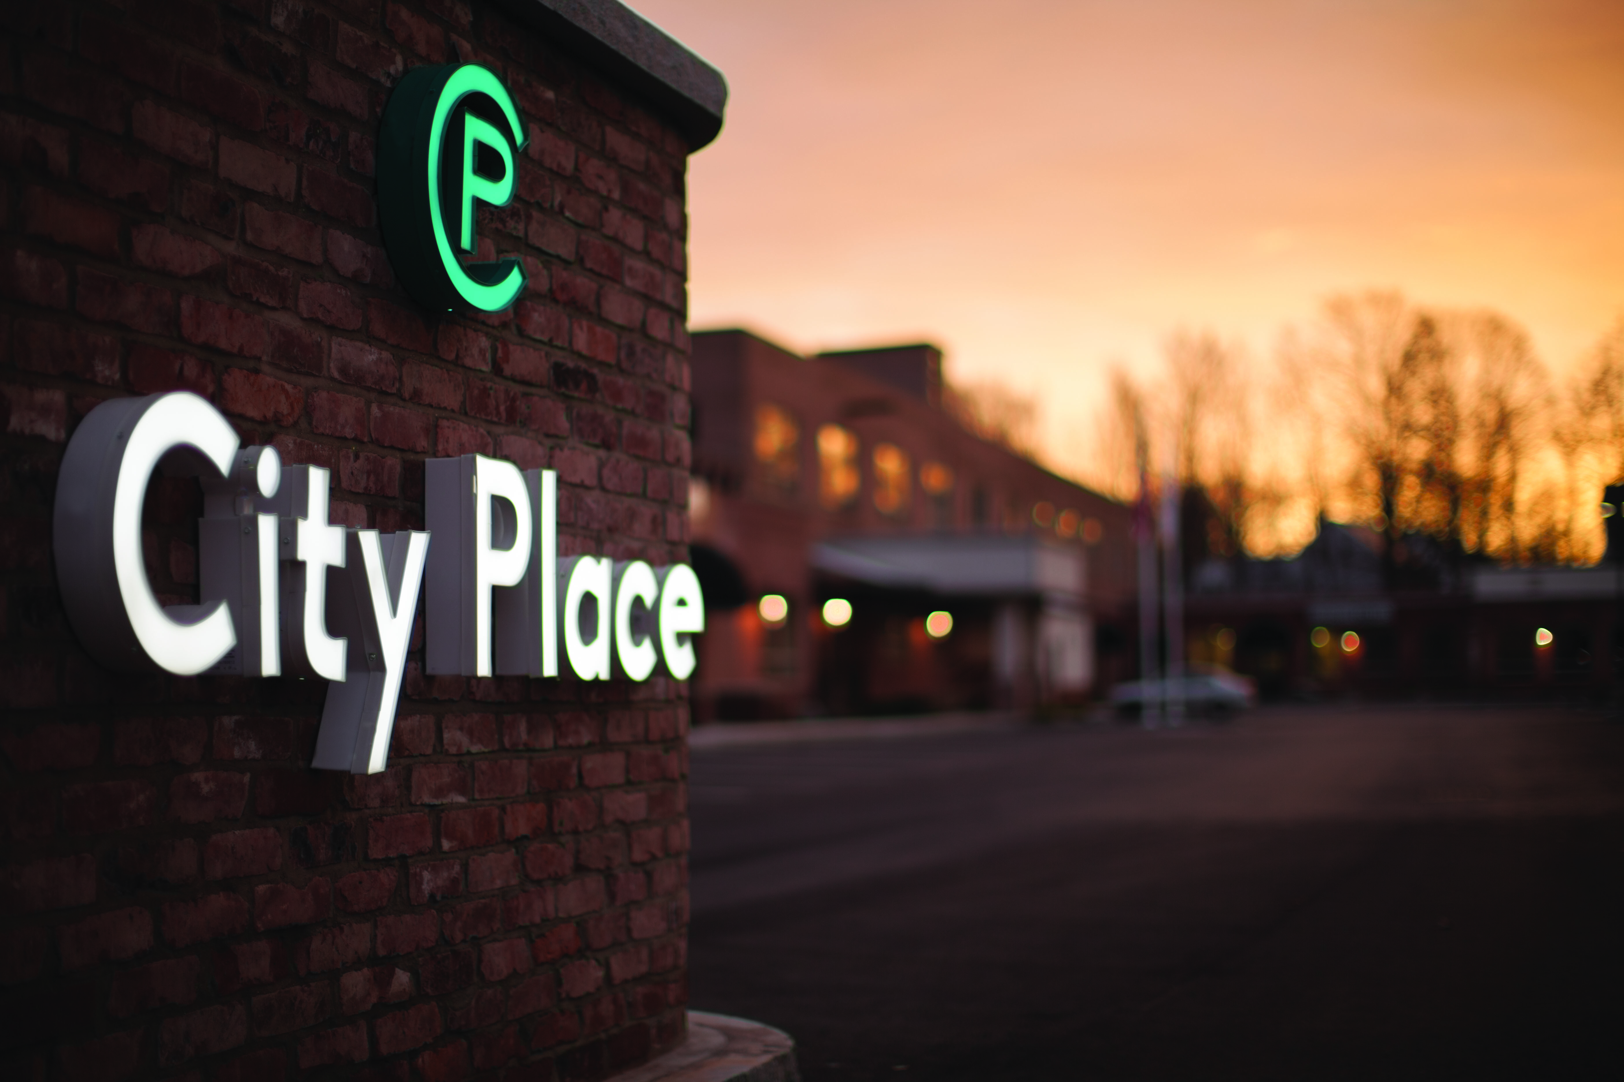


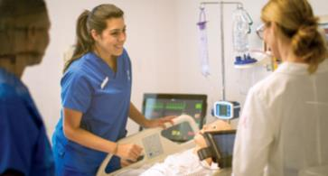
MassDevelopment
Massachusetts’ finance and development agency, working with businesses, nonprofits, banks, and communities to stimulate economic growth.
FY2022 Results
  Financed or managed 356 projects
  Invested more than $1.69 billion in the Massachusetts economy
  Created or supported 11,080 jobs and built or preserved 1,778 housing units

Slide 3







Who We Serve
Businesses
Helping companies expand, modernize,
and relocate.
Developers
Making the difference at every stage of development.
Housing
Building expertise, from predevelopment to construction.
Manufacturers
Finding skilled
employees, opening
global markets.
Municipalities
Eliminating blight, revitalizing downtowns, creating opportunities.
Nonprofits
Working with nonprofits to upgrade, renovate and expand.
Banks
Partnering with banks
to provide creative financing.

Slide 4
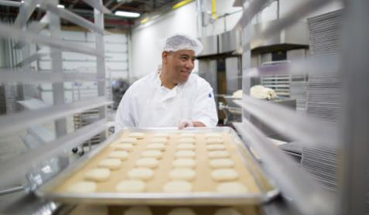
What We Offer
Finance
Bond Financing
Loans & Guarantees
Grants
Tax Credits
Finance
Real Estate
Technical Assistance
Development Projects

Slide 5

Partnering With Banks
Tax-Exempt Bonds
  Structuring bank loan as tax-exempt bond to pass on lower interest rate to customer
Loan participations
  Spreading risk
  Keeping customers
Loan Guarantees
  Supporting higher LTVs and LOC advance rates
  Sometimes in concert with tax-exempt bonds

Slide 6
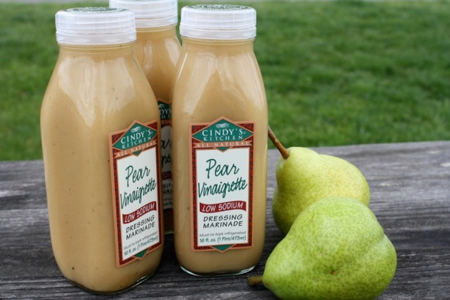
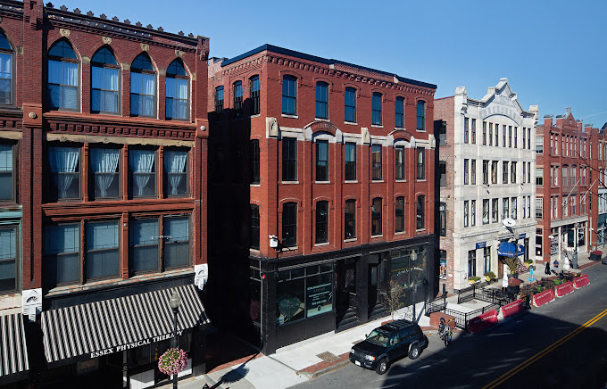
Lending Programs
MassDevelopment’s programs finance mainly real estate and equipment and include the following:
Real Estate Loans & Participations to $10,000,000
Equipment Loans to $3,000,000
Loan Guarantees to $4,000,000
State Small Business Credit Initiative (SSBCI) Loans and Guarantees
TechDollars Loans (non-profit technology equipment) up to $250K
Emerging Technology Fund – loans to $4 million (“venture loans”)
Brownfields Redevelopment Fund - $250K for site assessments and up to $750K for remediation

Slide 7
State Small Business Credit Initiative (SSBCI) Loans and Guarantees
Funded by American Rescue Plan Act Stimulus Bill in 2021
SSBCI transactions must have financing from private sector lender with exposure equal to or greater than the amount provided by SSBCI
SSBCI projects focus on supporting Socially or Economically Disadvantaged Individual (SEDI) - owned businesses in CDFI- Fund census tracts
For real estate: Must be 51% or more owner-occupied for existing buildings, or 61% owner-occupied for new construction

Slide 8
Eligibility for SSBCI funding
SSBCI financing can be used toward:
Loans for real estate acquisition, construction, and renovation (up to $10 million)
Loans for real estate improvements, term-working capital, and leasehold improvements (up to $2 million)
Equipment loans (between $100K and $3 million)
Guarantees on loans for real estate, equipment, and leasehold improvements (up to 50% of loan amount)
MassDevelopment uses SSBCI to provide loans and guarantees with extremely flexible terms where necessary to make projects happen. For example: subordinated positions, LTV > 100%, interest rate reductions to meet DSC, leasehold improvement loans, etc.

Slide 9
Example: Equipment Loan with SSBCI Guarantee
100% LTV Bank Loan; 20% Guarantee SSBCI
Source and Uses of Funds
Sources |  | Uses
Senior Loan 6.5% Bank With 20% Guarantee ($120,000 SSBCI) | $600,000 | Business Equipment | $600,000
Total | $600,000 | Total | $600,000

Slide 10
Example: RE Acquisition
51% owner-occupied
65% Loan to Project Value - Bank Loan
+ 35% Loan to Project Value - SSBCI
Source and Uses of Funds
Sources |  | Uses
Senior Loan 6.5% Bank 76% LTV | $845,000 | Property Purchase | $1,100,000
Junior Loan 2.5% SSBCI | $455,000 | Construction/Renovation | $200,000
Total | $1,300,000 | Total | $1,300,000

Slide 11
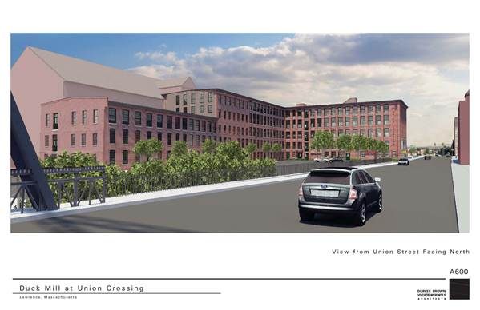
Brownfield Redevelopment Fund
$60,000,000 fund created by the Commonwealth
Mission is to focus on redevelopment of blighted areas in our communities
Up to $250,000 for site assessments in unsecured, zero-interest loans
Up to $750,000 in cleanup funds with flexible-term loans
There must be an economic development or housing project in order to access funds

Slide 12
Tax-Exempt Bond Financing
Provides a cost-effective method to finance capital projects
Funds used toward new equipment, building acquisition and expansion, land acquisition, new construction, debt refinancing (nonprofits only), some project soft costs
Advantages:
  Lower cost of capital (tax-exempt v. taxable)
  Increased debt capacity
  Customer can work with their existing banking relationship to purchase bond directly or provide credit for public market transactions
  Flexible structuring options including participation with multiple bond holders
  Access 4% tax credits for affordable rental housing projects

Slide 13
Bond Financing Structure
Bank buys bonds
MDFA loans to client
Bond Purchaser
(Bank)
Borrower
MassDevelopment
MassDevelopment
repays bonds
Borrower repays loan
  MassDevelopment acts as a “conduit”, capitalizing loans with proceeds from bond purchases
  Loans are pledged to repay bonds
  The bank underwrites, sets terms, and manages the relationship the same as it does for a client with a loan

Slide 14
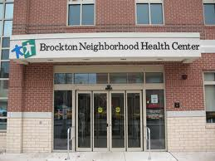
Eligible Borrowers-Bonds
Tax-exempt bond eligibility based on Federal tax code
  501(c)(3) Non-Profit Users
  ( i.e., colleges, hospitals, charter schools, cultural institutions, YMCAs,
  Boys & Girls Clubs, human service providers, long-term care providers,
  assisted living facilities nursing homes )
  Manufacturing Facilities
  Recycling / Environmental Facilities
  (solid waste disposal, including recycling)
  Affordable Rental Housing
  Infrastructure Financings
  Governmental Entities

Slide 15

PACE
Property Assessed Clean Energy
Property Assessed Clean Energy (PACE)
is a tax-based financing mechanism that
enables low-cost, long-term funding for
energy improvements
PACE financing is repaid via a betterment assessment on a property’s tax bill
PACE betterment assessments work similar to improvements for public infrastructure that benefit specific properties (i.e., sidewalk or sewer)

Slide 16

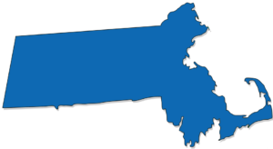

PACE in Massachusetts
PACE in Massachusetts
Commercial Property Assessed Clean Energy (PACE) was passed in H4568 and signed by Governor Baker in August 2016
  Amendment for PACE technical correction signed August 2019
MassDevelopment will act as Lead Program Administrator
MassDevelopment will administer the PACE Massachusetts program in consultation with the Massachusetts Department of Energy Resources
PACE guidelines, related information including RFI for Capital Providers available at:
www.massdevelopment.com/PACE

Slide 17
PA
PACE in Massachusetts
Communities that have adopted PACE Massachusetts
Acton | Agawam | Amesbury | Amherst | Barnstable | Bellingham | Beverly | Boston | Brockton | Burlington | Chelsea | Chicopee | Clinton | Concord | Devens | Dudley | East Longmeadow | Easthampton | Easton | Erving | Fall River | Fitchburg | Franklin | Gardner | Gloucester | Great Barrington | Greenfield | Holyoke | Hudson | Lanesborough | Lexington | Lowell | Ludlow | Lynn | Middleborough | Milton | Montague | New Bedford | Newton | North Adams | North Andover | Northampton | Norwood | Orange | Peabody | Pittsfield | Plymouth | Randolph | Rockland | Salem | Somerville | Southbridge | Springfield | Taunton | Wakefield | Wellfleet | Wendell | Westborough | West Springfield | Yarmouth
www.massdevelopment.com/PACE

Slide 18
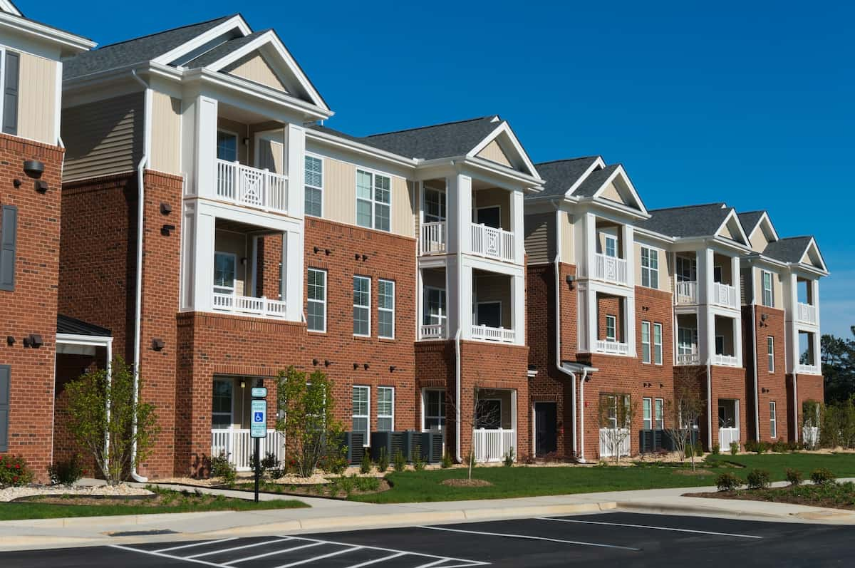
Eligible Properties:
Existing Buildings
Property Type
Commercial/Industrial
Not for profit
Multifamily (5 units or more)
Examples
Office buildings
Malls
Hotels
Restaurants
Manufacturers
YMCAs
Schools
Health Care
Apartment complexes

Slide 19

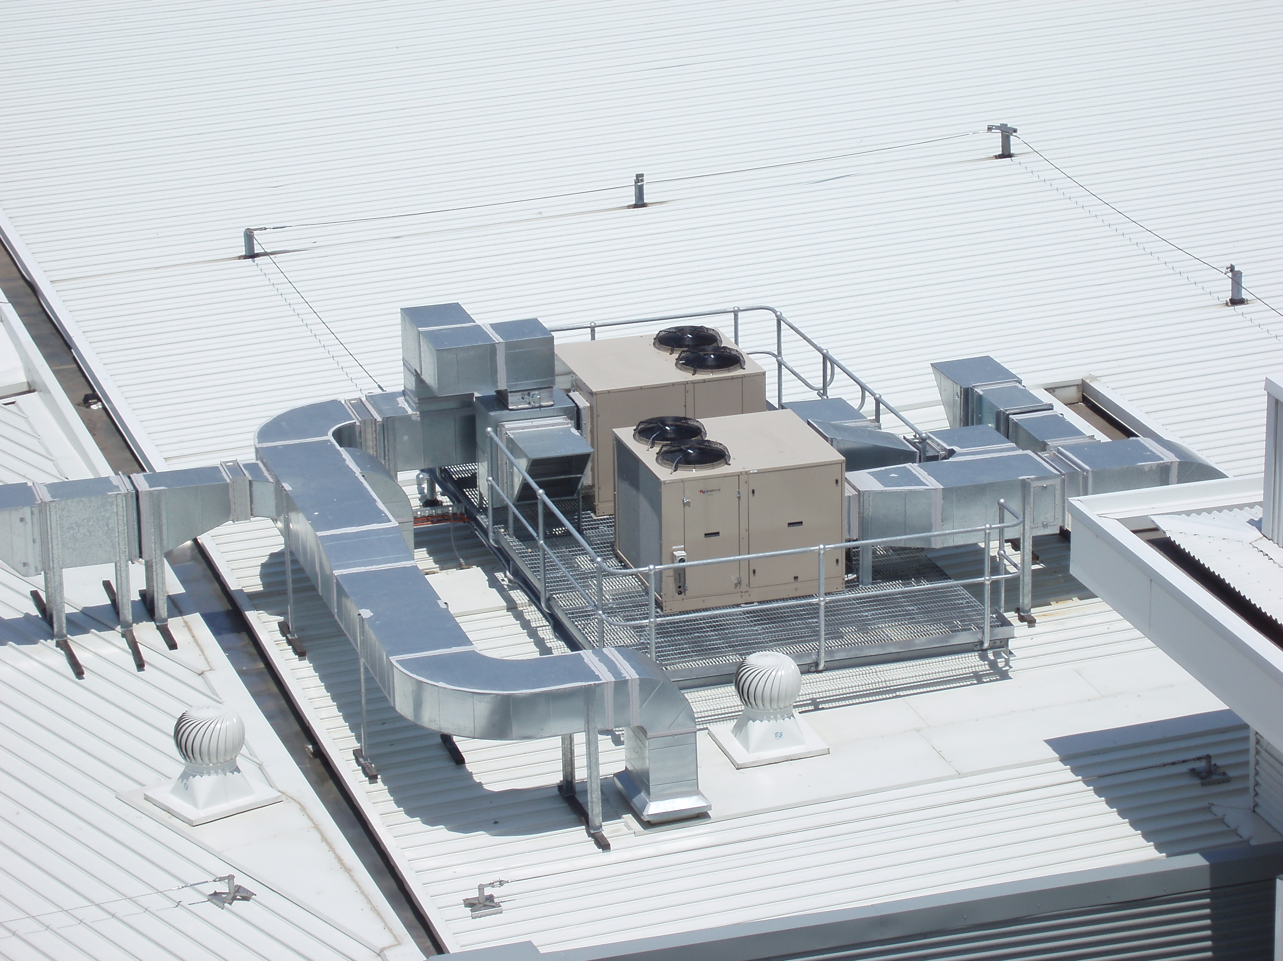
Eligible
PACE Improvements
Measure Type
Energy efficiency
Renewable energy
Gas line extensions
Potential Examples
Energy management systems
Insulation and air sealing
HVAC systems
Boilers and furnaces
Lighting
Energy Recovery and redistribution systems
Solar panels
Solar hot water
Geothermal

Slide 20
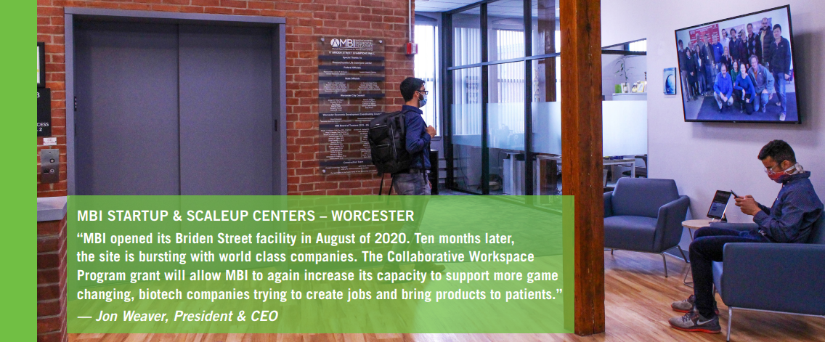
Collaborative Workspace &
Co-Working Spaces
  The Collaborative Workspace Program is a vehicle for the Commonwealth to accelerate business formation, job creation, and entrepreneurial activity in communities by supporting shared infrastructure and services that fuel locally based innovation.
  The program funds:
    Innovation
    centers
    Incubators
    Makerspaces
    Artists’ spaces
    Collaborative
    kitchens
  The Collaborative Workspace Program is part of the Community One Stop for Growth, a single application portal and collaborative review process of community and economic development grant programs that make targeted investments based on a Development Continuum. For more information, including key dates, frequently asked questions, and instructions on submitting an Expression of Interest and Full Application, please visit www.mass.gov/onestop.
Massachusetts Biomedical Initiatives, Worcester

Slide 21
Real Estate Planning:
Site Readiness Program
Objective Increase the Commonwealth’s inventory of large project ready sites
Eligible Applicants
Municipalities
Municipal agencies or authorities
Economic development and industrial corporations
Economic development authorities and non-profit entities
Eligible Uses
Site Preparation
  Site Concept Plans
  Site Market Studies
  Site Acquisition and Related Tasks
  Demolition
  Construction of Site-Related Upgrades
Predevelopment and Permitting
  Engineering Documents
  Permitting and Pre-Permitting
  Pro-Forma Development
  Due Diligence Activities
Program Highlights
MassDevelopment Project Management Assistance
Access to vetted House Doctor expertise
Awards between $50,000 - $1,000,000
No maximum project duration

Slide 22
Real Estate Planning:
Technical Assistance Programs
Objective Address site-specific and/or district-wide economic development challenges using Agency and / or local funding
Eligible Applicants / Consulting Clients
Municipality
Municipal agency
Other public entities
Eligible Uses Include:
Public Surplus Property Reuse
  Site Concept Plans and Market Feasibility Studies
  Request for Proposals/Qualifications
Local District Management Implementation Assistance
  District Improvement Financing (DIF)
  Business Improvement District (BID)
Program Highlights
MassDevelopment Project Management Assistance
Access to vetted House Doctor expertise
Awards of up to $50,000 through One Stop for Growth
Expedited Assistance available including consulting for a small project management fee.

Slide 23
Project Examples

Slide 24


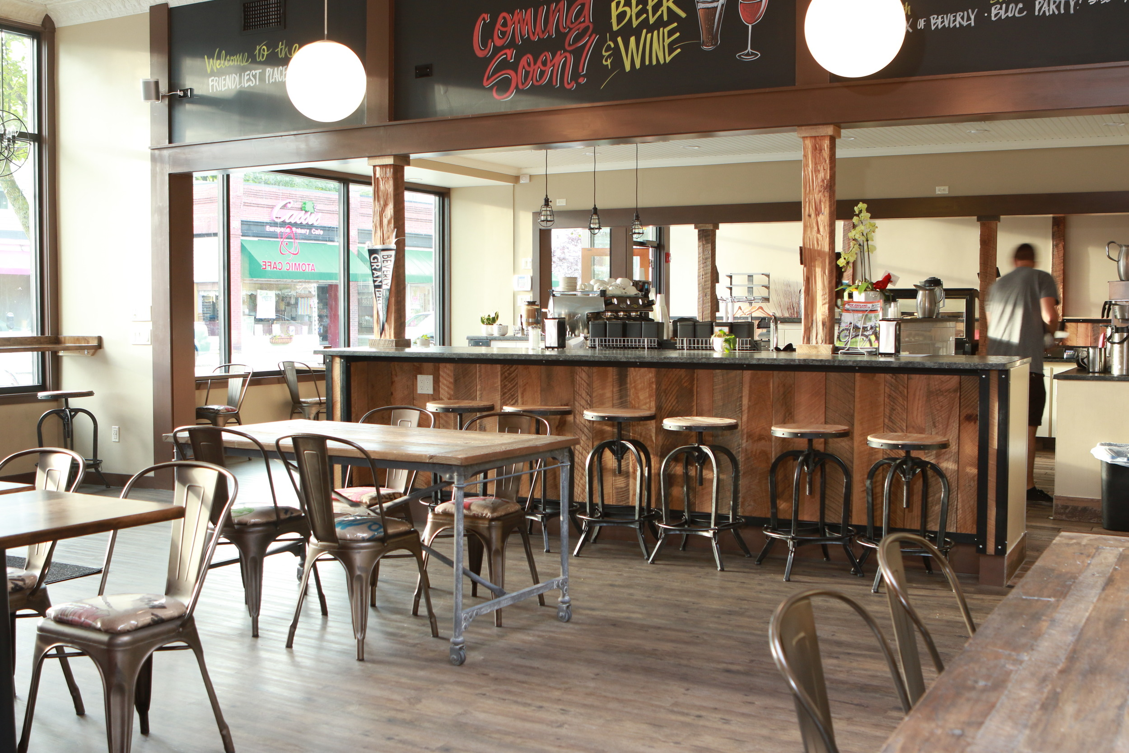
$350,000 Equipment Loan to Atomic Roasters, LLC to purchase equipment to expand its wholesale coffee and cold brew product line. Shift from store front retail operations to focus on roasting, production and distribution for the wholesale market.
  7 year term loan
Founded in 1996 in Beverly; roasting and cold brew
manufacturing in Salem and Danvers
  Estimated to create 35 new jobs

Slide 25

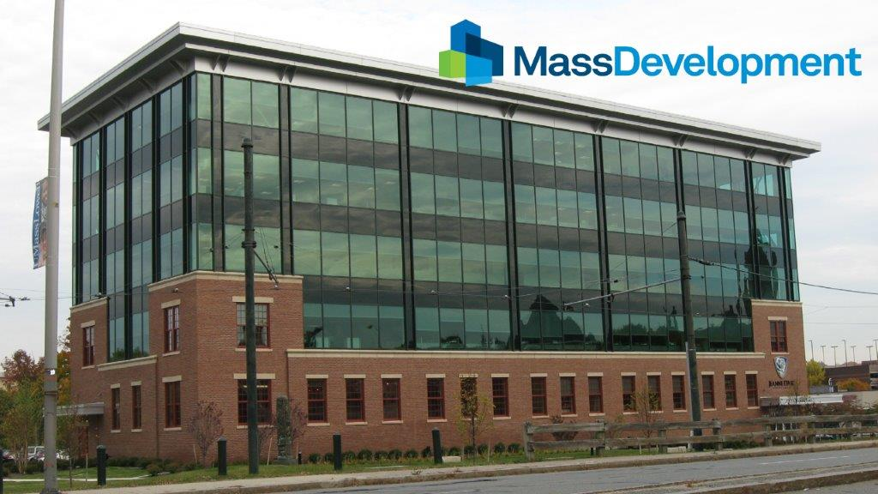
Jeanne d’Arc HQ
$4.2 million loan to Tremont Yard LLC, representing a 50 percent share in an $8.45 million loan from Enterprise Bank
  10 year term loan
Funds supported the construction of the 50,000 sq ft Jeanne d’Arc Credit Union Office in Lowell
  Creation of 5 new jobs in addition to 75 current jobs
Founded in Lowell in 1911, Jeanne d’Arc is the 6th largest credit union in the state.
Client also benefited from Predevelopment loan of $50,000 and Brownsfield assessment

Slide 26
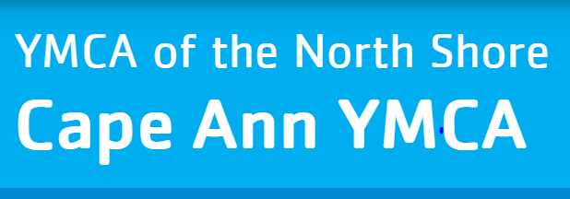
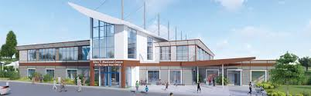

$13,000,000 Tax-Exempt Bond for the construction and equipping of a new two-story 62,800 square foot building on a section of the vacant Fuller School site in Gloucester.
The new space will include community meeting space, preschool classrooms, a health and wellness center, a gym & fitness studio, an indoor pool, an outdoor pool with spray park, café, and administrative offices

Slide 27

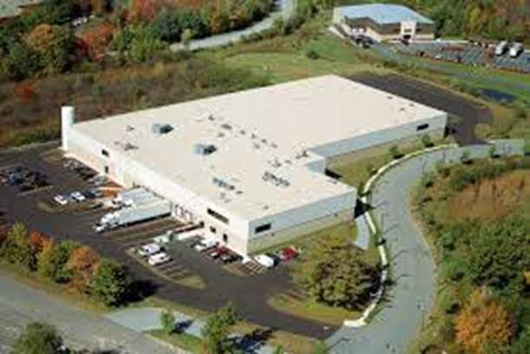
Loan Guarantee – Middle East Bakery, Lawrence
Founded in 1972, product sales and expansion led to desired purchase of 150,000 sq ft manufacturing facility
$10m purchase with Salem Five Cents Savings Bank
Insured 10% of the loan, allowing the Bank to lend up to 90% LTV
  MassDevelopment exposure ~$1.1m
Provided CRA credit by lending in a Gateway City

Slide 28

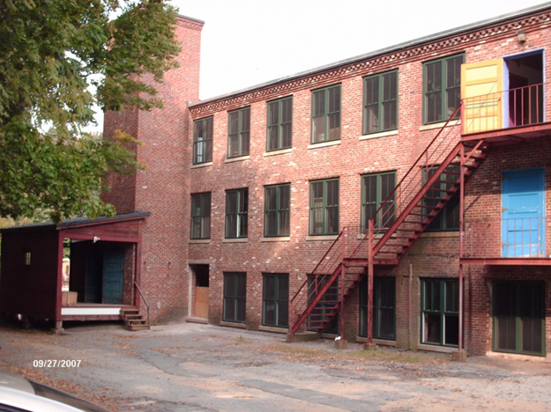
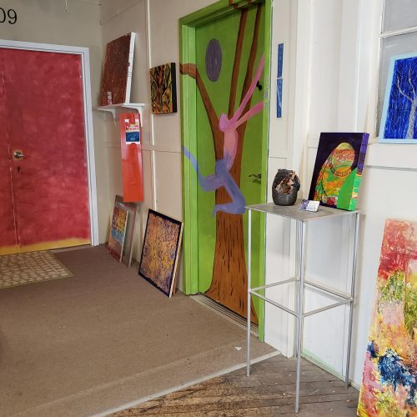
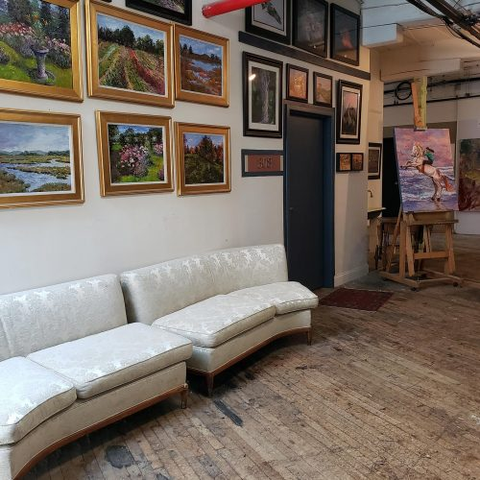
Brownfields Funds In Action
Historic mill building, close to Downtown
Blighted property, suppressing neighboring
property values
Chlorinated solvent contamination of soil
and groundwater
Ideal adaptive reuse for artist space
MassDevelopment:
Site Assessment Award – City of Amesbury $49,000
Remediation Loan – Cedar Tree Development $423,000
Construction Loan – Cedar Tree Development $1,062,000

Slide 29
PACE Project Overview: Greenfield
Abercrombie Building, 56 Bank Row
  Property: A blighted, historic 12,000 sq. ft. building
  in Western Mass that was rescued and transformed
  into vibrant office space.
  Project:
  Building systems needed major upgrades and
  PACE allowed owner to retroactively refinance
  the energy improvements and consolidate the
  outstanding bridge financing and private loans
  into a longer fixed repayment term
  Installed solar photovoltaic (PV) system on roof, efficient electrification of space heating, energy recovery ventilation, LED lighting and controls and improvements to windows and insulation
  Annually saves 189,000 kWh from the grid compared to a building built to current Mass. Energy Efficiency code
  Mortgage Holder consent obtained from bank
Amount financed: $450,000
Term: 20 yrs.

Slide 30
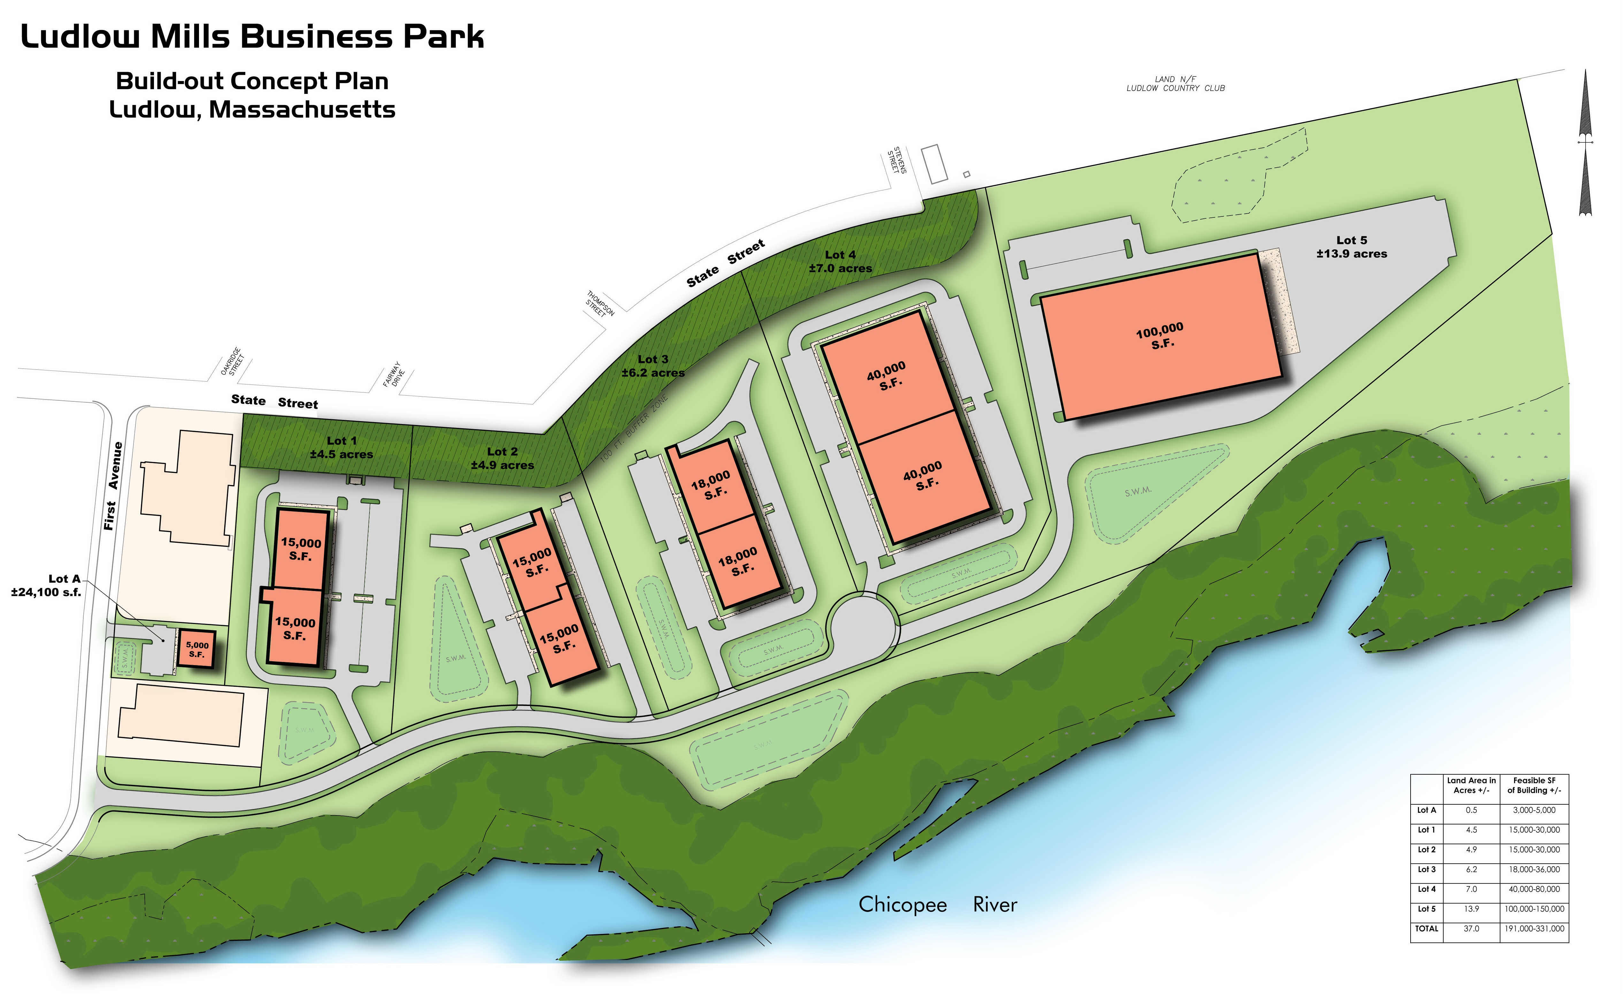
Site Readiness Program
Market Analysis and Build-Out Concepts
Grantee: Westmass Area Development Corporation
Scope of Work
Market Analysis Study
  Analyze Real Estate and Brokerage Data
  Expert Interviews
  Site Selection and Industry Trend Research
Land-Use Planning and Building Out Scenarios
  Land Use Feasibility Assessment
  Zoning Review
  Build Out Scenarios
Marketing Materials and Visuals
30

Slide 31
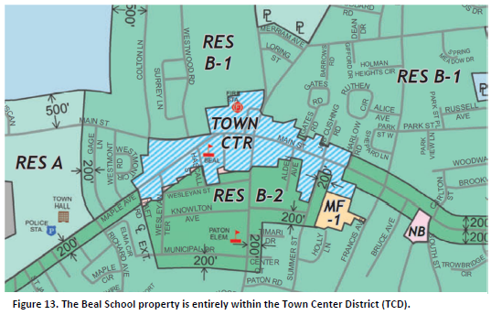
Real Estate Planning
District master plan and school reuse
Grantee: Town of Shrewsbury
Scope of Work
Existing Conditions Analysis
Market Data Analysis
Surveys and Community Engagement
Concept Planning for School Property
Town Center Master Plan with Zoning Recommendations
Followed by
Request for Proposals
Analysis of Proposal
31

Slide 32
Contact Information
MassDevelopment-North Region office: 370 Essex Street Lawrence, MA 01840
  David Bancroft, Senior Vice President, Community Investment
  (978) 459-6100 x1401 dbancroft@massdevelopment.com
  Taiwo Bello, Investment Bank Associate
  (617) 339-2049 tbello@massdevelopment.com
  Mike Galligan, Vice President, Commercial Lending
  (978) 459-6100 x1402 mgalligan@massdevelopment.com
  Dan Morais, Vice President, Green Finance
  (978) 459-6100 x1404 dmorais@massdevelopment.com
  Geetha Rao Ramani, Vice President, Business Development
  (978) 459-6100 x1405 or 978-273-6623 gramani@massdevelopment.com
  Nathanial Thomas, Vice President, Planning and PreDevelopment
  (617) 330-2091 nthomas@massdevelopment.com
Or visit our website at
www.massdevelopment.com

